Slide 1
Building a Crowdsensing Platform Based
on Spatio-Temporal Fencing
Authors:
Nobuhito Miyagawa,
Ryoga Tsuchimoto,
Shota Suzaki,Katsuhiko Kaji
FIT5046 2023S1 Lab03
Shixin Huang 31029248
Kai LIu 32737211
Notes:
Hello everyone, My name is SHIXIN huang and this is my partner Kailiu we are from Lab 03.
Our presentation topic today is Building a Crowdsensing Platform Based on Spatio-Temporal Fencing
Now let’s begin

Slide 2
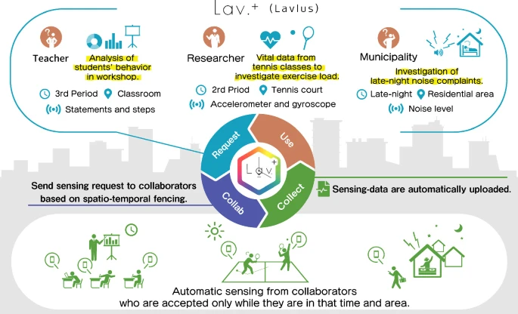
Introduction/Background
mobile and ubiquitous systems that can be accessed anytime and anywhere by various devices.
spatio-temporal fencing, which restricts the time and area of sensing, and construct a crowdsensing platform
Mobile crowdsensing serves as a critical building block for emerging Internet of Things (IoT) applications (Liu et al, 2018)
how to improve and maintain the motivation of collaborators in crowdsensing by providing them with convenience and a sense of security
the location protection for task allocation in mobile crowdsensing has not been well explored(Wang et al,2018)
Presenter SHXIN HUANG
Notes:
The research area is **mobile and ubiquitous systems**, which are computing and networking systems that can be accessed anytime and anywhere by various devices. which is a method of restricting the time and area of sensing, and how to provide convenience and sense of security to the requesters and collaborators of crowdsensing
And according to Liu’s paper in 2018. Mobile crowdsensing serves as a critical building block for emerging Internet of Things (IoT) applications
The main question in this paper- How to build a **crowdsensing platform** based on **spatio-temporal fencing**,
From (Wang et al,2018) the location protection for task allocation in mobile crowdsensing has not been well explored

Slide 3
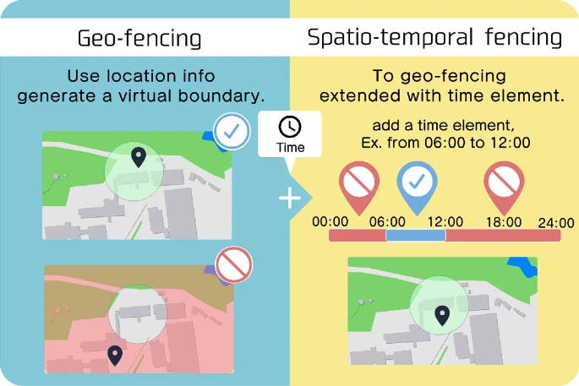
Proposed Approach/Solution
Building a Crowdsensing Platform Based on Spatio-Temporal Fencing.
The goal is to construct a crowdsensing platform based on this concept to provide convenience and sense of security to requesters and collaborators of crowdsensing.
Key components: The requester interface, The collaborator application, The platform server
Key innovation: simplifying request definition by setting spatio-temporal fencing and sensors to be used
Presenter SHXINHUANG
Notes:
The approach is to design and implement a crowdsensing platform called Lavlus(
拉夫卢斯), which allows requesters to define crowdsensing tasks by setting up spatio-temporal fencing and choosing the sensors to be used. The platform also allows collaborators to participate in crowdsensing tasks by installing a common smartphone application that automatically performs sensing when they enter or exit the spatio-temporal fencing. The platform simplifies the definition of the request and makes it easy to use, while providing a sense of security to collaborators by reducing privacy barriers caused by concerns about data provision and sensing
The key components of Lavlus are:
- The requester interface, which allows requesters to define crowdsensing tasks by setting up spatio-temporal fencing and choosing the sensors to be used. The interface also provides feedback on the task progress and results.
- The collaborator application, which allows collaborators to participate in crowdsensing tasks by installing a common smartphone application that automatically performs sensing when they enter or exit the spatio-temporal fencing. The application also provides feedback on the task participation and rewards.
- The platform server, which manages the crowdsensing tasks and coordinates the communication between requesters and collaborators. The server also performs data processing and analysis on the collected sensor data.
The key innovation of Lavlus is:
- The use of spatio-temporal fencing as a novel way of defining crowdsensing tasks that reduces the complexity and increases the flexibility for requesters and collaborators. Spatio-temporal fencing allows requesters to specify when and where sensing should be performed, and allows collaborators to sense only when they are in proximity to the task area. This reduces the privacy concerns and battery consumption for collaborators, and improves the quality and quantity of sensor data for requesters.

Slide 4
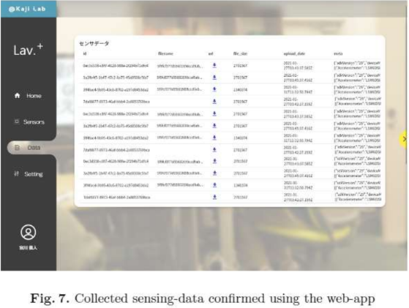
Evaluation
User registers in the web-app
Installs the app in the smartphone
Verify that the server, web app, and smartphone app can request the and receive items
Web-app create project
Send an authentication message when the user enters the spatio-temporal fence area
Web-app creates the project and authenticates with the server
Sensing starts, the user enters the induction area when the induction starts, and the user leaves when the induction stops
Upload data when WIFI is connected
Spatio-Temporal Fencing is used by companies such as Amazon, Uber and Walmart(Bellatreche et al., 2021).
Presenter Kai Liu
Notes:
Hello everyone, I am Kai, and I will introduce the evaluation and conclusion part of the experiment. Here is the experiment process in the article.User registration, server verification, project creation, software operation, data upload (ao san ti kei shen)After the user registers, the user needs to interact with the software only in the sixth step (ie step F) of the software operation, which provides convenience and enhances the enthusiasm of the user. In addition, the experiment using spatio-temporal fencing technology is on the right track, as large companies such as Walmart are also using it.

Slide 5
Conclusion
Main Contribution
High Quality Article
1.Verified the effectiveness of the crowd-sensing platform based on space-time fence technology
2.Increased user and stakeholder engagement
3.Effectively reduce user cost
1.Rigorous design methodology
2.Follow checklists
3.Providing the correct statistics
4.Up-to-date equipment
Limitation
Unresolved Issues
GPS positioning is inaccurate indoor areas
1.User Privacy Information Protection
2.An operating system for experimenting with the Zhongsense platform has not been established
Improve for Limitation
Prediction method based on improved HMM model combined with historical trajectory clustering(Zhang et al., 2019)
Presenter Kai Liu
Notes:
The paper and experiment adopts a rigorous (rui guai si ) design method, conducts experiments according to plan, provides scientific experimental data statistics, and uses the latest equipment for experiments. It can be known that this is a high-quality paper and experiment. This paper demonstrates the effectiveness of the crowd-sensing technology based on the spatio-temporal fencing through experiments, and improves the enthusiasm of users and stakeholders by simplifying the operation steps. However, this experiment did not solve the problem of user privacy protection. At the same time, this technology has limitations. For the instability of indoor GPS information acquisition, it is impossible to define the change area in detail. For this problem, Prediction method based on improved HMM model combined with historical trajectory (chuo zhai ke chuo rui)clustering caous te ing can be used to solve it.

Slide 6
Reference
Miyagawa, N., Tsuchimoto, R., Suzaki, S., & Kaji, K. (2022). Building a Crowdsensing Platform Based on Spatio-Temporal Fencing. Lecture Notes of the Institute for Computer Sciences, Social Informatics and Telecommunications Engineering, 797–809. https://doi.org/10.1007/978-3-030-94822-1_52
Shixin Huang
Liu, J., Shen, H., Narman, H. S., Chung, W., & Lin, Z. (2018). A survey of mobile crowdsensing techniques: A critical component for the internet of things. ACM Transactions on Cyber-Physical Systems, 2(3), 1-26.
Wang, Z., Hu, J., Lv, R., Wei, J., Wang, Q., Yang, D., & Qi, H. (2018). Personalized privacy-preserving task allocation for mobile crowdsensing. IEEE Transactions on Mobile Computing, 18(6), 1330-1341.https://ieeexplore.ieee.org/abstract/document/8423074
Kai Liu
Bellatreche, Ladjel, Goyal, Vikram, Fujita, Hamido, Mondal, Anirban, & Reddy, P. Krishna. (2021). i-Fence: A Spatio-Temporal Context-Aware Geofencing Framework for Triggering Impulse Decisions. In Big Data Analytics (Vol. 12581, pp. 63–80). Springer International Publishing AG. https://doi.org/10.1007/978-3-030-66665-1_5
Zhang, Ping, Jiang, Qianqian, Zhang, Ruilin, & Li, Bo. (2019). Research and Implementation of Key Techniques for Indoor Movement Object Trajectory Prediction. Journal of Physics. Conference Series, 1215(1), 12020. https://doi.org/10.1088/1742-6596/1215/1/012020

